Slide 1

Lecture 09: Digital System Design
Dept. of Computer Sc. and Engg.
University of Rajshahi
www.ru.ac.bd
Dr. Mahboob Qaosar

Slide 2
Evolution of Computer-Aided Digital Design
SSI: Small scale integration
A few gates on a chip
MSI: Medium scale integration
Hundreds of gates on a chip
LSI: Large scale integration
Thousands of gates on a chip
CAD: Computer-Aided Design
CAD vs. CAE
Logic and circuit simulators
Prototyping on bread board
Layout by hand (on paper or a computer terminal)

Slide 3
Evolution of Computer-Aided Digital Design (cont’d)
VLSI: Very Large Scale Integration
Hundred thousands of gates
Not feasible anymore:
Bread boarding
Manual layout design
Simulator programs
Automatic place-and-route
Bottom-Up design
Design small building blocks
Combine them to develop bigger ones
More and more emphasis on logic simulation

Slide 4
HDL: Hardware Description Language
HDL is designed for circuit verification and simulation, for timing analysis, for test analysis (testability analysis and fault grading) and for logic synthesis.
before you get to the structural level of your design, you want to make sure the logical paths of your design is faultless and meets the spec.
HDLs allowed the designers to model the concurrency of processes found in hardware elements.
The Digital circuits could be described at a register transfer level (RTL) by using HDL.
Used for simulation of system boards; interconnect buses, FPGAs (Field Programmable Gate Arrays), and PALs (Programmable Array Logic).
Example: Verilog HDL, VHDL

Slide 5
Design specification
Behavioral description
RTL description (HDL)
Functional verification and testing
Logic synthesis/timing verification
Gate-Level Netlist
Logic verification and testing
Floor planning Automatic place and Route
Physical layout
Layout verification
Implementation
HDL Design Flow

Slide 6
Importance of HDLs
Retargeting to a new fabrication technology
Functional verification earlier in the design cycle
Textual concise representation of the design
Similar to computer programs
Easier to understand

Slide 7
Popularity of Verilog HDL
Verilog HDL
General-purpose
Easy to learn, easy to use
Similar in syntax to C
Allows different levels of abstraction and mixing them
Supported by most popular logic synthesis tools
Post-logic-synthesis simulation libraries by all fabrication vendors
PLI to customize Verilog simulators to designers’ needs

Slide 8
Trends in HDLs
Design at behavioral level
Formal verification techniques
Very high speed and time critical circuits
e.g. microprocessors
Mixed gate-level and RTL designs
Hardware-Software Co-design
System-level languages: SystemC, SpecC, …

Slide 9
Basics of Digital Design Using HDLs
Stimulus block
Circuit Under Design (CUD)
Generating inputs to CUD
Checking outputs of CUD
4
8
Test bench

Slide 10
Verilog Basic Building Block
Module
module not_gate(in, out); // module name+ports
// comments: declaring port type
input in;
output out;
// Defining circuit functionality
assign out = ~in;
endmodule

Slide 11
Hierarchical Modeling Concepts
Top Level
Module
E.g.
Full Adder
Sub-Module
1
Sub-Module
2
Half Adder
Half Adder
Basic Module
1
Basic Module
2
Basic Module
3

Slide 12
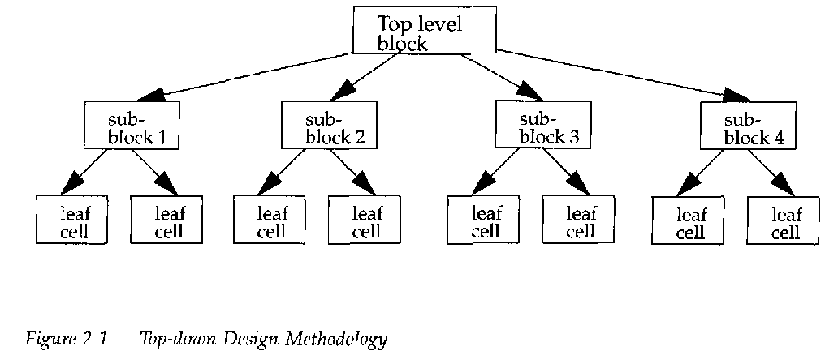
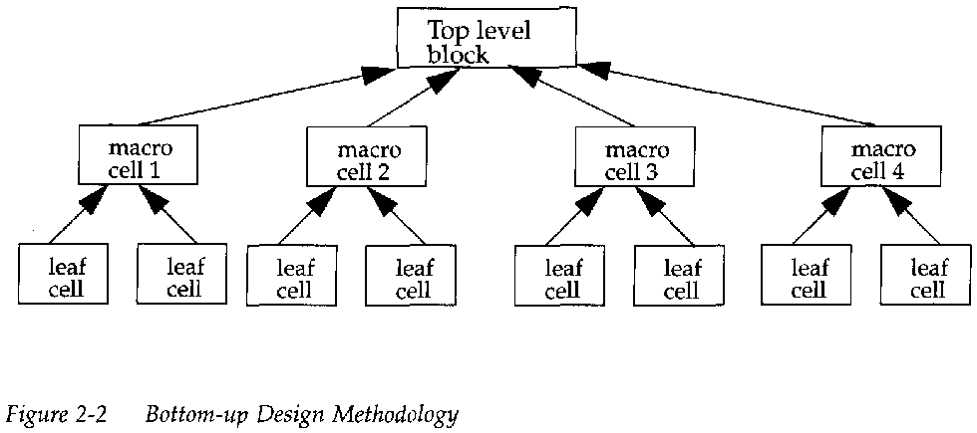
Design Methodologies

Slide 13
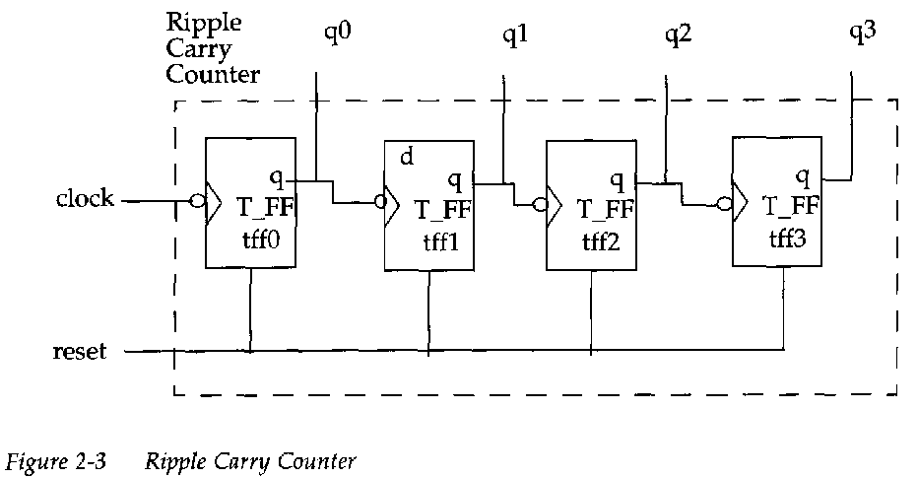
4-bit Ripple Carry Counter

Slide 14
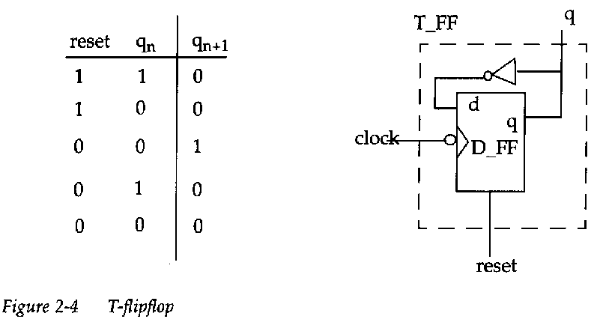
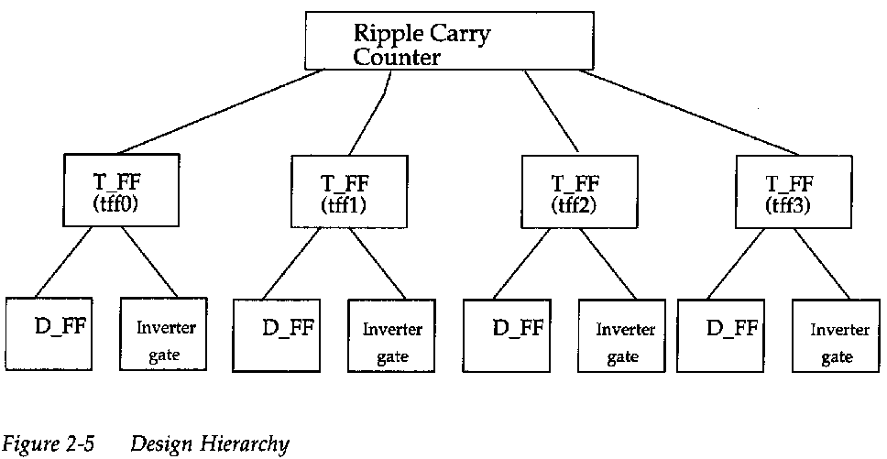
T-flipflop and the Hierarchy

Slide 15
Modules
module <module_name>(<module_terminal_list>);
...
<module internals>
...
endmodule
Example:
module T_ff(q, clock, reset);
...
<functionality of T_flipflop>
...
endmodule

Slide 16
Modules (cont’d)
Verilog supported levels of abstraction
Behavioral (algorithmic) level
Describe the algorithm used
Very similar to C programming
Dataflow level
Describe how data flows between registers and is processed
Gate level
Interconnect logic gates
Switch level
Interconnect transistors (MOS transistors)

Slide 17
Instance
A module provides a template which you can create actual objects.
When a module is invoked, Verilog creates a unique object from the template
The process of creating a object from module template is called instantiation
The object is called instance

Slide 18
Instances
module ripple_carry_counter(q, clk, reset);
output [3:0] q;
input clk, reset;
//4 instances of the module TFF are created.
TFF tff0(q[0],clk, reset);
TFF tff1(q[1],q[0], reset);
TFF tff2(q[2],q[1], reset);
TFF tff3(q[3],q[2], reset);
endmodule

Slide 19
Instances (cont’d)
module TFF(q, clk, reset);
output q;
input clk, reset;
wire d;
DFF dff0(q, d, clk, reset);
not n1(d, q); // not is a Verilog provided primitive.
endmodule
// module DFF with asynchronous reset
module DFF(q, d, clk, reset);
output q;
input d, clk, reset;
reg q;
always @(posedge reset or negedge clk)
if (reset)
q = 1'b0;
else
q = d;
endmodule

Slide 20
Instances (cont’d)
Illegal instantiation example:
Nested module definition not allowed
Note the difference between module definition and module instantiation
// Define the top level module called ripple carry
// counter. It is illegal to define the module T_FF inside
// this module.
module ripple_carry_counter(q, clk, reset);
output [3:0] q;
input clk, reset;
module T_FF(q, clock, reset);// ILLEGAL MODULE NESTING
:
<module T_FF internals>
:
endmodule // END OF ILLEGAL MODULE NESTING
endmodule

Slide 21
Gates
Basic element for designing a digital logic circuit
Verilog supports basis logic gates as predefined primitives
installed like modules
predefined in Verilog (do not need a module definition)
Basic Gates:
and/or : one scalar output and multiple scalar inputs
buf/not : one scalar input and one or more scalar outputs
Other predefined gates: xor, nand, nor, xnor

Slide 22
Ports
Ports provide the interface by which a module can communicate with its environment
input/output pins of an IC chip are its ports
A module definition contains an optional list of ports
If the module does not exchange any signals with the environment, there are no ports in the list

Slide 23
Ports (cont.)
Top
a
Full adder
(4-bit)
fulladd4
sum
b
c_{out}
c_{in}
module fulladd4(sum, c_out, a, b, c_in);
module Top

Slide 24
Ports (cont.)
Port Declaration
input : Input port
Output : Output port
inout : Bidirectional port
module fulladd4(sum, c_out, a, b, c_in);
//begin port declarations section
output [3:0] sum;
output c_out;
input [3:0] a, b;
input c_in;
//end port declaration section
.......
<module internals>
.......
endmodule;

Slide 25
Ports (cont.)
Port Connection Rules
net
net inout
input
net
output
reg or net
reg or net
net

Slide 26
Verilog Value Set
0 represents low logic level or false condition
1 represents high logic level or true condition
x represents unknown logic level
z represents high impedance logic level

Slide 27
Numbers in Verilog (i)
<size>’<radix> <value>
8’h ax = 1010xxxx
12’o 3zx7 = 011zzzxxx111
No of
bits
Binary → b or B
Octal → o or O
Decimal → d or D
Hexadecimal → h or H
Consecutive chars
0-f, x, z

Slide 28
Numbers in Verilog (ii)
You can insert “_” for readability
12’b 000_111_010_100
12’b 000111010100
12’o 07_24
Bit extension
MS bit = 0, x or z ⇒ extend this
4’b x1 = 4’b xx_x1
MS bit = 1 ⇒ zero extension
4’b 1x = 4’b 00_1x
Represent the same number

Slide 29
Numbers in Verilog (iii)
If size is ommitted it
is inferred from the value or
takes the simulation specific number of bits or
takes the machine specific number of bits
If radix is ommitted too .. decimal is assumed
15 = <size>’d 15

Slide 30
Nets (i)
Can be thought as hardware wires driven by logic
Equal z when unconnected
Various types of nets
wire
wand (wired-AND)
wor (wired-OR)
tri (tri-state)
In following examples: Y is evaluated, automatically, every time A or B changes

Slide 31


Nets (ii)
A
wire Y; // declaration
assign Y = A & B;
Y
B
wand Y; // declaration
assign Y = A;
assign Y = B;
A
Y
B
wor Y; // declaration
assign Y = A;
assign Y = B;
dr
A
Y
tri Y; // declaration
assign Y = (dr) ? A : z;

Slide 32
Registers
Variables that store values
Do not represent real hardware but ..
.. real hardware can be implemented with registers
Only one type: reg
reg A, C; // declaration
// assignments are always done inside a procedure
A = 1;
C = A; // C gets the logical value 1
A = 0; // C is still 1
C = 0; // C is now 0
Register values are updated explicitly!!

Slide 33
Vectors
Represent buses
wire [3:0] busA;
reg [1:4] busB;
reg [1:0] busC;
Left number is MS bit
Slice management
busC[1] = busA[2];
busC[0] = busA[1];
Vector assignment (by position!!)
busB[1] = busA[3];
busB[2] = busA[2];
busB[3] = busA[1];
busB[4] = busA[0];
busC = busA[2:1]; ⇔
busB = busA; ⇔

Slide 34
Integer & Real Data Types
Declaration
integer i, k;
real r;
Use as registers (inside procedures)
i = 1; // assignments occur inside procedure
r = 2.9;
k = r; // k is rounded to 3
Integers are not initialized!!
Reals are initialized to 0.0

Slide 35
Time Data Type
Special data type for simulation time measuring
Declaration
time my_time;
Use inside procedure
my_time = $time; // get current sim time
Simulation runs at simulation time, not real time

Slide 36
Arrays (i)
Syntax
integer count[1:5]; // 5 integers
reg var[-15:16]; // 32 1-bit regs
reg [7:0] mem[0:1023]; // 1024 8-bit regs
Accessing array elements
Entire element: mem[10] = 8’b 10101010;
Element subfield (needs temp storage):
reg [7:0] temp;
..
temp = mem[10];
var[6] = temp[2];

Slide 37
Arrays (ii)
Limitation: Cannot access array subfield or entire array at once
var[2:9] = ???; // WRONG!!
var = ???; // WRONG!!
No multi-dimentional arrays
reg var[1:10] [1:100]; // WRONG!!
Arrays don’t work for the Real data type
real r[1:10]; // WRONG !!

Slide 38
Strings
Implemented with regs:
reg [8*13:1] string_val; // can hold up to 13 chars
..
string_val = “Hello Verilog”;
string_val = “hello”; // MS Bytes are filled with 0
string_val = “I am overflowed”; // “I ” is truncated
Escaped chars:
\n newline
\t tab
%% %
\\ \
\“ “

Slide 39
Logical Operators
&& → logical AND
|| → logical OR
! → logical NOT
Operands evaluated to ONE bit value: 0, 1 or x
Result is ONE bit value: 0, 1 or x
A = 6; A && B → 1 && 0 → 0
B = 0; A || !B → 1 || 1 → 1
C = x; C || B → x || 0 → x
but C && B = 0

Slide 40
Bitwise Operators (i)
& → bitwise AND
| → bitwise OR
~ → bitwise NOT
^ → bitwise XOR
~^ or ^~ → bitwise XNOR
Operation on bit by bit basis

Slide 41
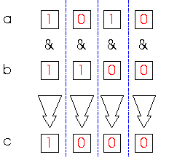
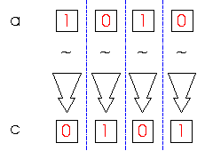
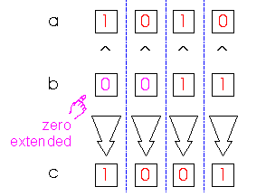
Bitwise Operators (ii)
c = ~a;
c = a & b;
a = 4’b1010;
b = 2’b11;
a = 4’b1010;
b = 4’b1100;
c = a ^ b;

Slide 42
Reduction Operators
& → AND
| → OR
^ → XOR
~& → NAND
~| → NOR
~^ or ^~ → XNOR
One multi-bit operand → One single-bit result
a = 4’b1001;
..
c = |a; // c = 1|0|0|1 = 1

Slide 43
Shift Operators
>> → shift right
<< → shift left
Result is same size as first operand, always zero filled
a = 4’b1010;
...
d = a >> 2; // d = 0010
c = a << 1; // c = 0100

Slide 44
Concatenation Operator
{op1, op2, ..} → concatenates op1, op2, .. to single number
Operands must be sized !!
reg a;
reg [2:0] b, c;
..
a = 1’b 1;
b = 3’b 010;
c = 3’b 101;
catx = {a, b, c}; // catx = 1_010_101
caty = {b, 2’b11, a}; // caty = 010_11_1
catz = {b, 1}; // WRONG !!
Replication ..
catr = {4{a}, b, 2{c}}; // catr = 1111_010_101101

Slide 45
Relational Operators
> → greater than
< → less than
>= → greater or equal than
<= → less or equal than
Result is one bit value: 0, 1 or x
1 > 0 → 1
’b1x1 <= 0 → x
10 < z → x

Slide 46
Equality Operators
== → logical equality
!= → logical inequality
=== → case equality
!== → case inequality
4’b 1z0x == 4’b 1z0x → x
4’b 1z0x != 4’b 1z0x → x
4’b 1z0x === 4’b 1z0x → 1
4’b 1z0x !== 4’b 1z0x → 0
Return 0, 1 or x
Return 0 or 1

Slide 47
Conditional Operator
cond_expr ? true_expr : false_expr
Like a 2-to-1 mux ..
A
1
Y
B
Y = (sel)? A : B;
0
sel

Slide 48
Arithmetic Operators (i)
+, -, *, /, %
If any operand is x the result is x
Negative registers:
regs can be assigned negative but are treated as unsigned
reg [15:0] regA;
..
regA = -4’d12; // stored as 2¹⁶-12 = 65524
regA/3 evaluates to 21861

Slide 49
Arithmetic Operators (ii)
Negative integers:
can be assigned negative values
different treatment depending on base specification or not
reg [15:0] regA;
integer intA;
..
intA = -12/3; // evaluates to -4 (no base spec)
intA = -’d12/3; // evaluates to 1431655761 (base spec)

Slide 50
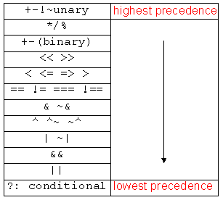
Operator Precedence
Use parentheses to
enforce your
priority

Slide 51
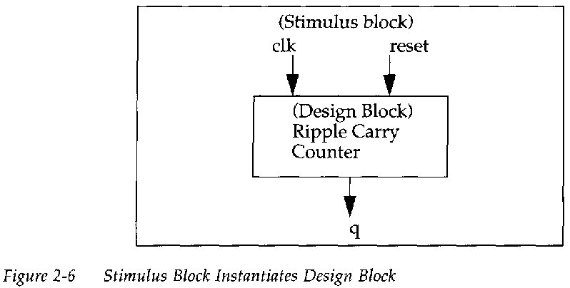
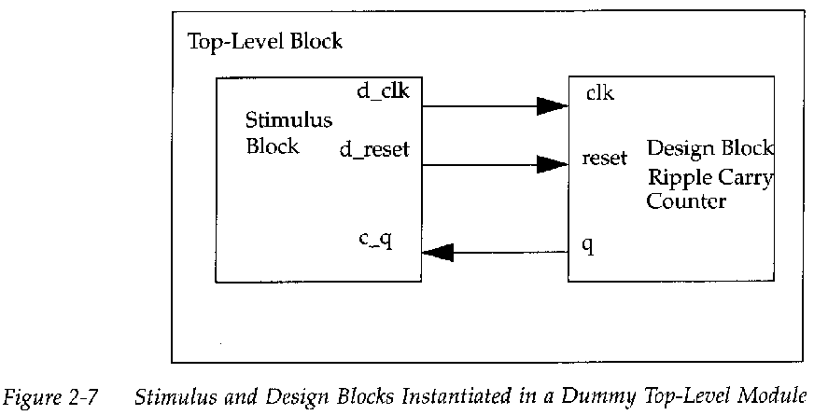
Simulation- Test Bench Styles

Slide 52
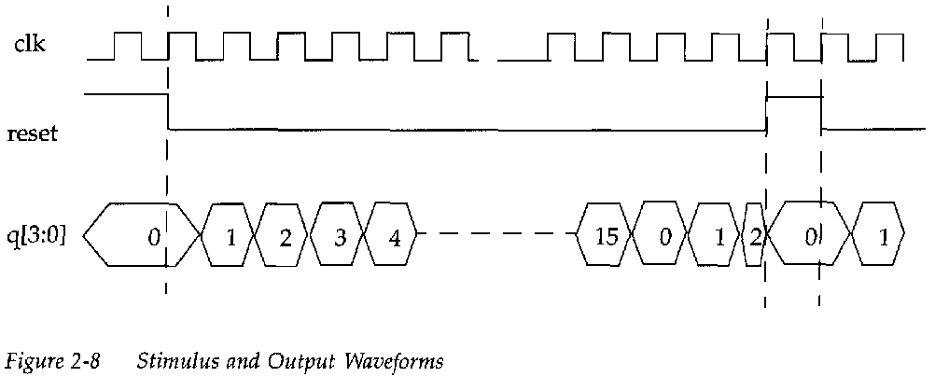
Example
Design block was shown before
ripple_carry_counter, T_FF, and D_FF modules
Stimulus block

Slide 53
Example (cont’d)
module stimulus;
reg clk; reg reset; wire[3:0] q;
// instantiate the design block
ripple_carry_counter r1(q, clk, reset);
// Control the clk signal that drives the design block.
initial clk = 1'b0;
always #5 clk = ~clk;
// Control the reset signal that drives the design block
initial
begin
reset = 1'b1;
#15 reset = 1'b0;
#180 reset = 1'b1;
#10 reset = 1'b0;
#20 $stop;
end
initial // Monitor the outputs
$monitor($time, " Output q = %d", q);
endmodule

